Slide 1

Department of Computer Science and Engineering
191CS87A-PROJECT REVIEW-1
CAR MILEAGE PREDICTION
Team Members:
Mohana Krishnan -113119UG03058
Nikhil -113119UG03062
Sunil Ahamed - 113119UG03105
Kanagasabai -113119UG03045
Guided by,
Dr. M.Victore jose
M.E ,Ph.D
Professor
Dept of CSE.
Batch No: 20
Date : 3.03.2022

Slide 2
OUTLINE OF THE PRESENTATION
OBJECTIVE
ABSTRACT
EXISTING SYSTEM
DISADVANTAGES
LITERATURE SURVEY
PROPOSED SYSTEM
ADVANTAGES
SOFTWARE REQUIREMENT
LIST OF MODULES
CONCLUSION
REFERENCES
2

Slide 3
Objective
First we have to collect the dataset and then we have to pre-process/clean the dataset using different data pre-processing techniques. Later we have to classify if it is a regression or a classification kind of problem.
Also we have to analyze or get insights into data through data visualization .
Then we have to apply “Random Forest” algorithms to the dataset and based on visualization . Also, we have to improve the efficiency of the vehicle by applying bivariate and multivariate analysis.
Then we have to build a web application using the html,css,python and Flask framework.

Slide 4
Abstract
Predicting the performance level of cars is an important and interesting problem. The main goal is to predict the performance of the car to improve certain behaviour of the vehicle. This can significantly help to improve the system's fuel consumption and increase efficiency. The performance analysis of the car is based on the engine type, no of engine cylinders, fuel type, horsepower, etc. These are the factors on which the health of the car can be predicted. It is an ongoing process of obtaining, researching, analyzing, and recording health based on the above three factors. The performance objectives like mileage, dependability, flexibility and cost can be grouped together to play a vital role in the prediction engine and engine management system. This approach is a very important step towards understanding the vehicle's performance.

Slide 5
Existing System
The Existing System analyses the correlation between fuel efficiency of a car and its characteristics and driving behaviour.
The model is developed using machine learning techniques such as Multiple Linear Regression, Support Vector Machine, Artificial Neural Network and XG Boost considering vehicle characteristics and driving behaviour as input data to predict the fuel efficiency of a small passenger car.
It proposes the optimum throttle position and other characteristics that would help in achieving better fuel efficiency and thereby reduce fuel consumption and emissions.

Slide 6
Disadvantages
The algorithm XG Boost does not perform so well on sparse and unstructured data .
The other drawback is that Gradient Boosting is very sensitive to outliers since every classifier is forced to fix the errors in the predecessor learners.
The overall method is hardly scalable. This is because the estimators base their correctness on previous predictors, hence the procedure involves a lot of struggle to streamline.

Slide 7
Literature Survey
Machine learning based real-time vehicle data analysis for safe driving modeling :
-Tamul Yadav , Sangsu Jung & DhananjaySingh : 2019
This paper identifies a necessity to evaluate the Meta features of vehicles which could be helpful in improving the vehicle driver's skill to prevent accidents and also evaluate the change in the quality of cars over passing time.
TECHNOLOGIES USED :
Supervised Learning, Linear Regression, Statistical Analysis, Automotive Vehicle Data.

Slide 8
Performance of Motor Vehicle based on Driving and Vehicle Data using Machine Learning : - Punith Kumar Nagaraje Gowda : 2019
The primary objective of this paper was to develop a model using machine
learning techniques which precisely predicts the fuel efficiency and to propose
the optimum driving style and vehicle characteristics to achieve better fuel
efficiency.
TECHNOLOGIES USED:
Multiple linear regression, Artificial neural network, Support vector regression, XG BOOST and Linear SVR.

Slide 9
Proposed system
The main goal of the proposed system is to predict the performance of the car to improve certain behaviours of the vehicle. This can significantly help to improve the system's fuel consumption and increase efficiency.
This model is developed using Machine learning algorithm such as Random Forest Regression / Classification and Data visualization technique using python. The model should be trained and once the model is trained , it’s ready to make predictions.
In this new performance objectives like mileage, dependability, flexibility and cost can be grouped together to play a vital role in the prediction engine and engine management system.

Slide 10
Advantages
The random forest can perform both regression and classification tasks.
A random forest produces good predictions that can be understood easily.
It can handle large datasets efficiently ,Thus improving efficiency of the model.
The random forest algorithm provides a higher level of accuracy in predicting outcomes over the decision tree algorithm.

Slide 11
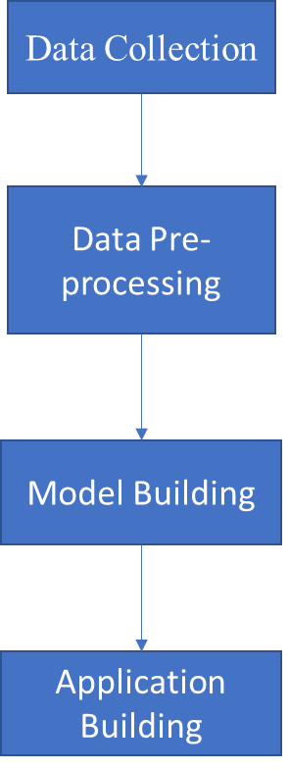
Flow Diagram

Slide 12
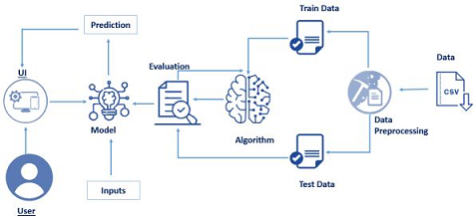
Technical Architecture

Slide 13
Software Requirements
Software Tool : Anaconda Navigator
Operating System : Windows 7 or Above
Processors : Any Intel or AMD X86-64 processor
RAM : 8GB
Graphics Card : No Specific graphics card required

Slide 14
Hardware Requirements
Operating System : Windows 7 or Above
Processor : Intel Core 2 DUO / AMD Athlon 64 X2 5600+
Memory : 8GB RAM
Resolution : 1024*768 minimum display resolution

Slide 15
List of Modules
1. Data Collection
2. Data Pre-processing
3. Model Building
4. Application Building

Slide 16
Task to be performed
1. Install Anaconda Navigator.
2. Install Required Libraries.
3. Data Collection.
a. Collect the dataset or Create the dataset
4. Data Preprocessing.
a. Import the Libraries.
b. Importing the dataset.
c. Checking for Null Values.
d. Data Visualization.
e. Taking care of Missing Data.
f. Label encoding.
g. One Hot Encoding.
h. Feature Scaling.
i. Splitting Data into Train and Test.

Slide 17
Model Building
a. Training and testing the model
b. Evaluation of Model
6. Application Building
a. Create an HTML file
b. Build a Python Code

Slide 18
CONCLUSION
In this project we have tried to implement an machine learning based vehicle analyzer using algorithms such as Random forest regression/Classification and used data visualization methods for analysis of data. By performing this steps we tried to increase the efficiency of the models by performing bi-variate and multivariate analysis. The performance objectives like mileage, dependability, flexibility and cost can be grouped together to play a vital role in the prediction engine and engine management system. This approach is a very important step towards understanding the vehicle's performance.

Slide 19
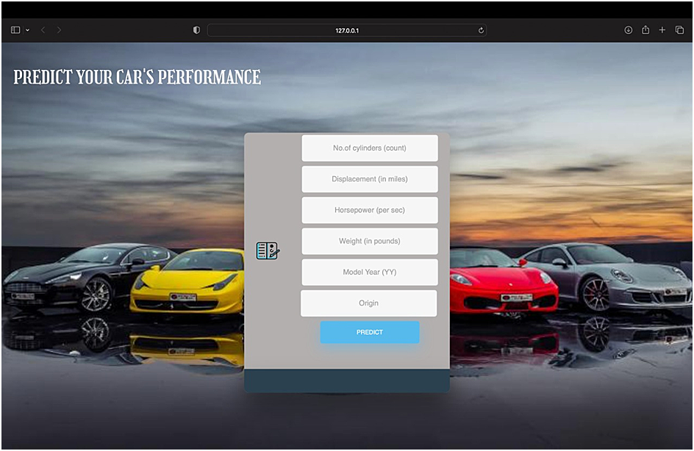
SCREENSHOTS
HOME PAGE :

Slide 20
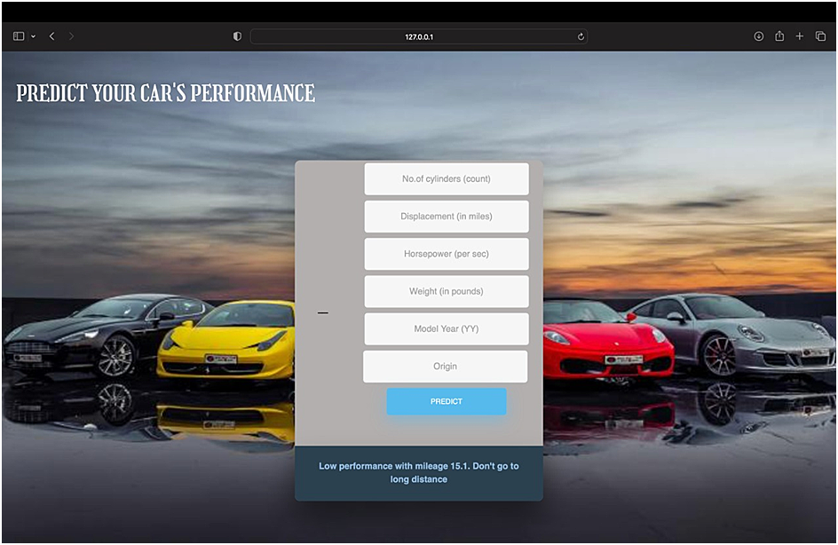
RESULT PAGE :

Slide 21
REFERENCES
Byerly , A., Hendrix, B., Bagwe, R., Santos, E. and Ben-Miled , Z. (2019). A machine learning model for average fuel consumption in heavy vehicles, IEEE Transactions on Vehicular Technology, 68(7), 6343-6351, doi: 10.1109/TVT.2019.2916299 .
Ping, P., Qin, W., Xu, Y., Miyajima, C. and Takeda, K. (2019). Impact of Driver Behavior on Fuel Consumption: Classification, Evaluation and Prediction Using Machine Learning, IEEE Access, doi: 10.1109/access.2019.2920489
Perrotta, F., Parry, T. and Neves , L. C. (2018). Application of machine learning for fuel consumption modelling of trucks, Proceedings- 2017 IEEE International Conference on Big Data, Big Data 2017, doi: 10.1109/BigData.2017.8258382.

Slide 22
THANK YOU

